Slide 1
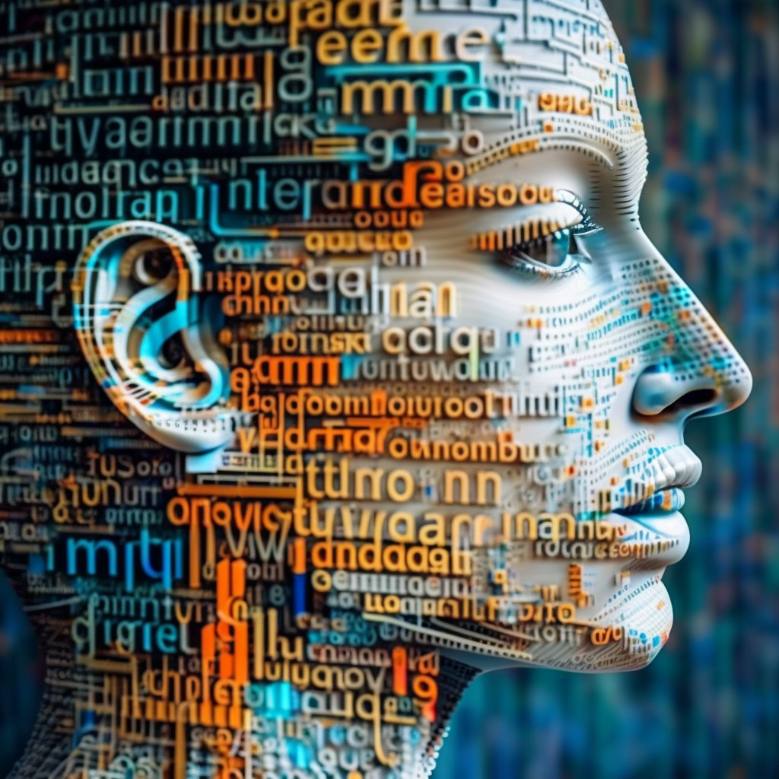

sequence modeling
midjourney bot (2023)
Machine Learning Methods for Biomedical Data (D012554)

Slide 2
sequence modeling
Where does the ball go next?
Machine Learning Methods for Biomedical Data (D012554)
Notes:
Also convex!

Slide 3
sequence modeling
Where does the ball go next?
??
Machine Learning Methods for Biomedical Data (D012554)
Notes:
Also convex!

Slide 4
sequence modeling
Where does the ball go next?
Machine Learning Methods for Biomedical Data (D012554)
Notes:
Also convex!

Slide 5
sequence modeling
Where does the ball go next?
Machine Learning Methods for Biomedical Data (D012554)
Notes:
Also convex!

Slide 6
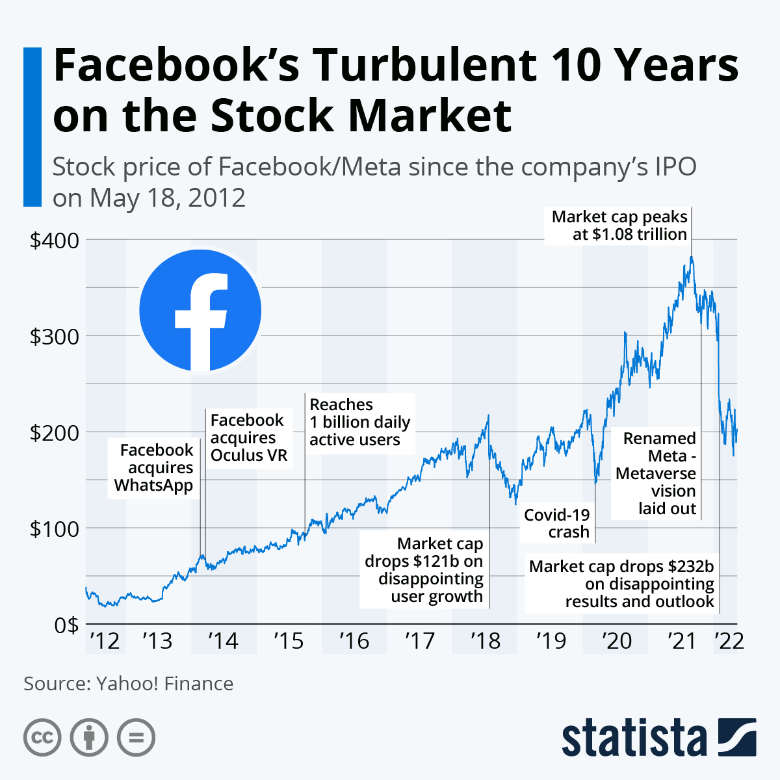
sequence modeling
text
video streams
audio streams
genomics, transcriptomics, proteomics
stock markets
weather, climate
electrocardiogram
…
Machine Learning Methods for Biomedical Data (D012554)
Notes:
Also convex!

Slide 7
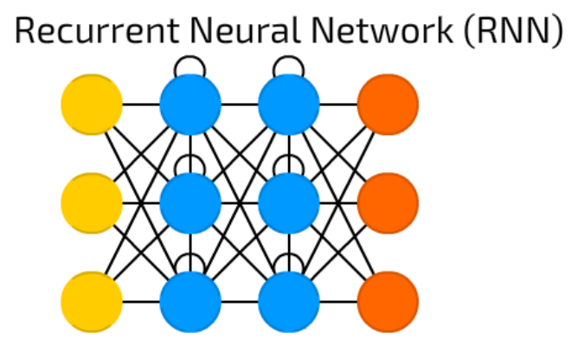
sequence modeling
Sequences can have variable length, which makes it hard to represent them as fixed length feature vectors.
The recurrent neural network module is designed to tackle this issue.
Machine Learning Methods for Biomedical Data (D012554)
Notes:
Also convex!

Slide 8
sequence modeling
sentiment classification
protein function prediction
stock market price prediction
gene expression prediction
video topic classification
…
one to one many to one
Machine Learning Methods for Biomedical Data (D012554)
Notes:
Also convex!

Slide 9

sequence modeling
A classroom with students discussing the future of AI in healthcare, photorealistic.
one to one many to one
Machine Learning Methods for Biomedical Data (D012554)
Notes:
Also convex!

Slide 10
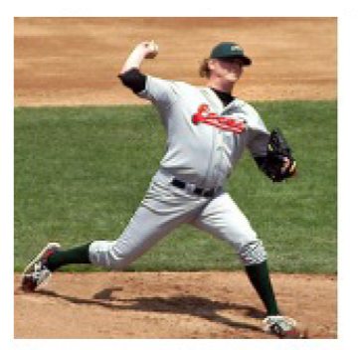
sequence modeling
A baseball player throwing a ball.
one to one one to many
Machine Learning Methods for Biomedical Data (D012554)
Notes:
Also convex!

Slide 11
sequence modeling
one to one many to many
Machine Learning Methods for Biomedical Data (D012554)
Notes:
Also convex!

Slide 12
sequence modeling
text translation
protein secondary structure prediction
MS/MS spectrum prediction
peptide identification
…
one to one many to many
Machine Learning Methods for Biomedical Data (D012554)
Notes:
Also convex!

Slide 13
sequence modeling
text translation
protein secondary structure prediction
MS/MS spectrum prediction
peptide identification
…
one to one many to many
encoder
decoder
Machine Learning Methods for Biomedical Data (D012554)
Notes:
Also convex!

Slide 14
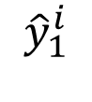
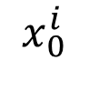
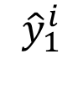

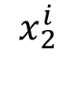
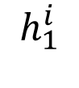
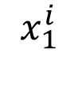
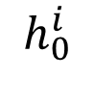
recurrent neural network (RNN)
It is important to realize that the modelparameters of the RNN are the same in each time-step, i.e. the green part in the diagram is always the same.
$${\hat{y}}_{0}^{i}$$
$${\hat{y}}_{1}^{i}$$
$${\hat{y}}_{1}^{i}$$
$$h_{0}^{i}$$
$$h_{1}^{i}$$
$$x_{0}^{i}$$
$$x_{1}^{i}$$
$$x_{2}^{i}$$
Machine Learning Methods for Biomedical Data (D012554)
Notes:
Also convex!

Slide 15
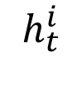
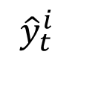
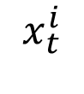
recurrent neural network (RNN)
It is important to realize that the modelparameters of the RNN are the same in each time-step, i.e. the green part in the diagram is always the same.
So, we can also represent the RNN as shown on the left.
$${\hat{y}}_{t}^{i}$$
$${\hat{y}}_{0}^{i}$$
$${\hat{y}}_{1}^{i}$$
$${\hat{y}}_{1}^{i}$$
$$h_{t}^{i}$$
$$h_{0}^{i}$$
$$h_{1}^{i}$$
$$x_{t}^{i}$$
$$x_{0}^{i}$$
$$x_{1}^{i}$$
$$x_{2}^{i}$$
Machine Learning Methods for Biomedical Data (D012554)
Notes:
Also convex!

Slide 16

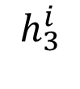
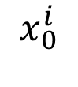
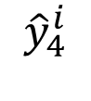
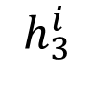
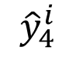

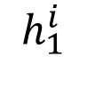
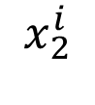

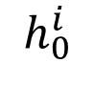
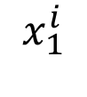
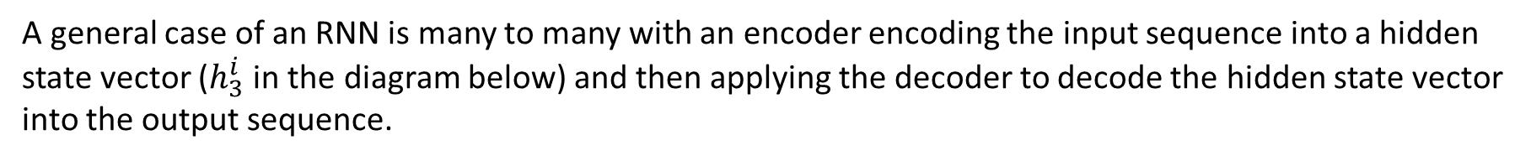
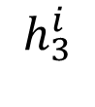
RNN encoding - decoding
A general case of an RNN is many to many with an encoder encoding the input sequence into a hidden state vector ($h_{3}^{i}$ in the diagram below) and then applying the decoder to decode the hidden state vector into the output sequence.
$${\hat{y}}_{3}^{i}$$
$${\hat{y}}_{4}^{i}$$
$${\hat{y}}_{5}^{i}$$
$$h_{0}^{i}$$
$$h_{1}^{i}$$
$$h_{3}^{i}$$
$$h_{3}^{i}$$
$$h_{3}^{i}$$
$$x_{0}^{i}$$
$$x_{1}^{i}$$
$$x_{2}^{i}$$
<stop>
$${\hat{y}}_{3}^{i}$$
$${\hat{y}}_{4}^{i}$$
Machine Learning Methods for Biomedical Data (D012554)
Notes:
Also convex!

Slide 17
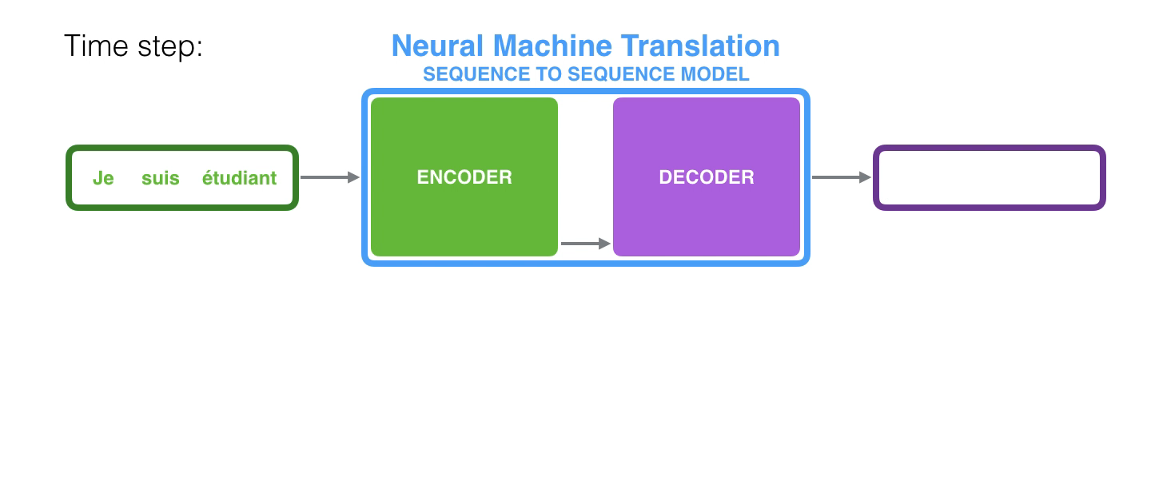
RNN encoding - decoding
Folded this looks like this.
https://jalammar.github.io/visualizing-neural-machine-translation-mechanics-of-seq2seq-models-with-attention/
Machine Learning Methods for Biomedical Data (D012554)

Slide 18
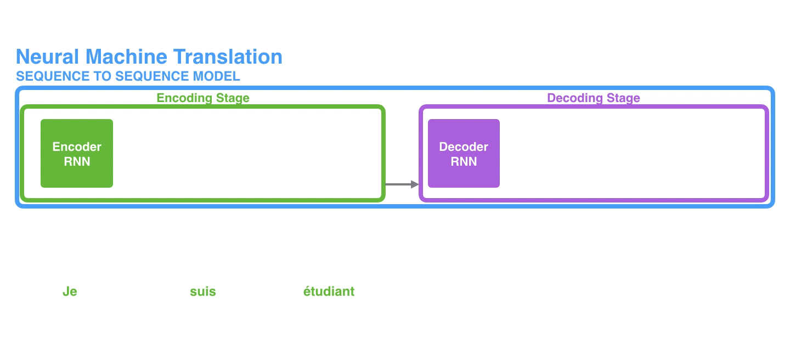
RNN encoding - decoding
Unfolded this looks like this.
This creates a bottleneck in which all information in the input sequence needs to be encoded into the final hidden state vector.
This puts limitations to the length of the input sequence.
https://jalammar.github.io/visualizing-neural-machine-translation-mechanics-of-seq2seq-models-with-attention/
Machine Learning Methods for Biomedical Data (D012554)

Slide 19
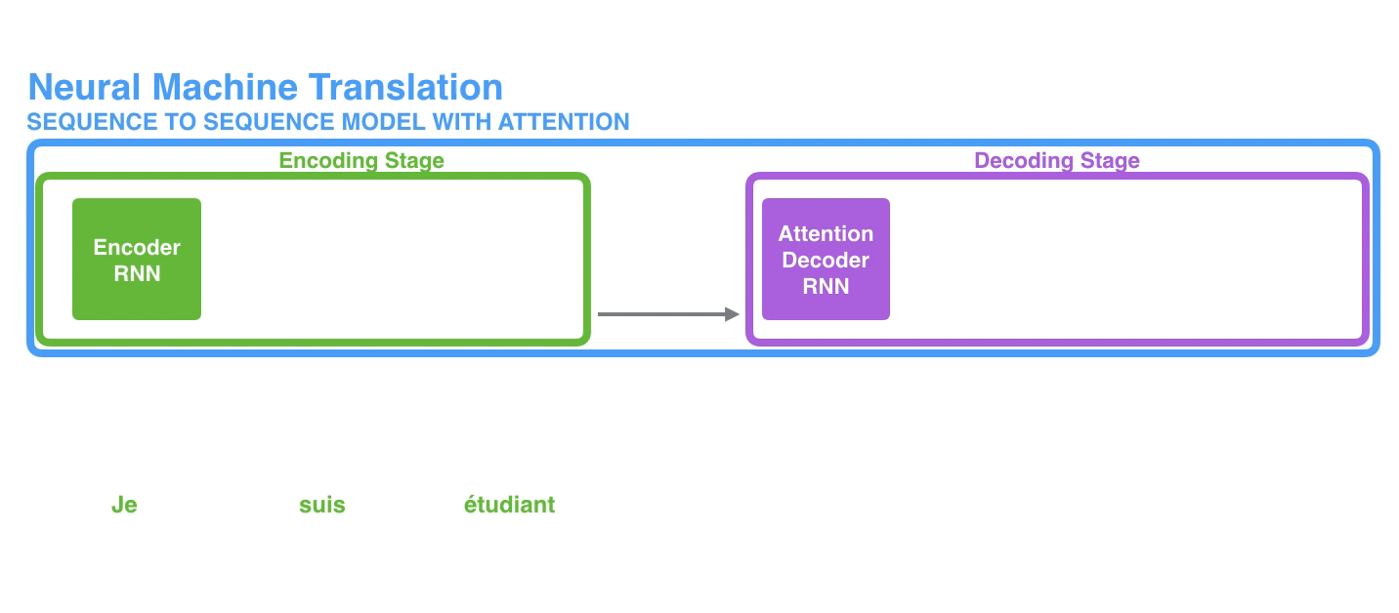
RNN encoding - decoding
One way to solve this issue is to use a hidden state vectors to decode.
But this can create an information overflow during decoding.
https://jalammar.github.io/visualizing-neural-machine-translation-mechanics-of-seq2seq-models-with-attention/
Notes:
The context vector turned out to be a bottleneck for these types of models. It made it challenging for the models to deal with long sentences
A solution was proposed in Bahdanau et al., 2014 and Luong et al., 2015. These papers introduced and refined a technique called “Attention”, which highly improved the quality of machine translation systems. Attention allows the model to focus on the relevant parts of the input sequence as needed.

Slide 20
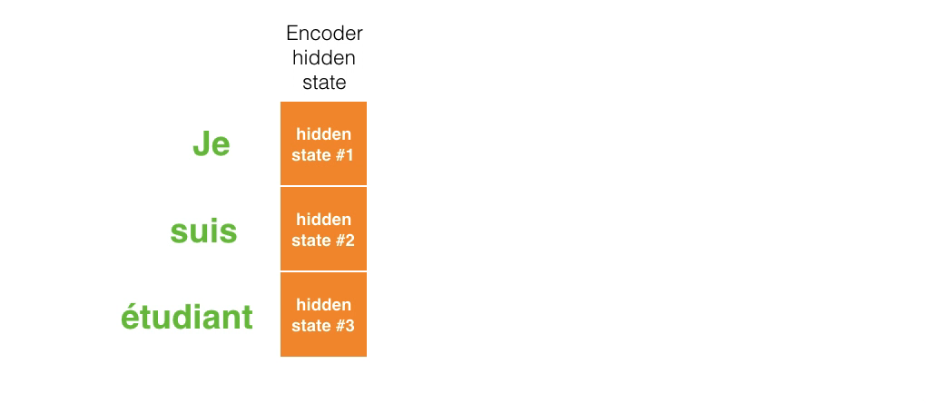
learning to pay attention
This issue can be solved by adding an attention layer. This is again a specialized architecture with modelparameters that learns to pay more or less attention to the specific hidden state vectors during each time-step in the decoding.
https://jalammar.github.io/visualizing-neural-machine-translation-mechanics-of-seq2seq-models-with-attention/
Machine Learning Methods for Biomedical Data (D012554)

Slide 21
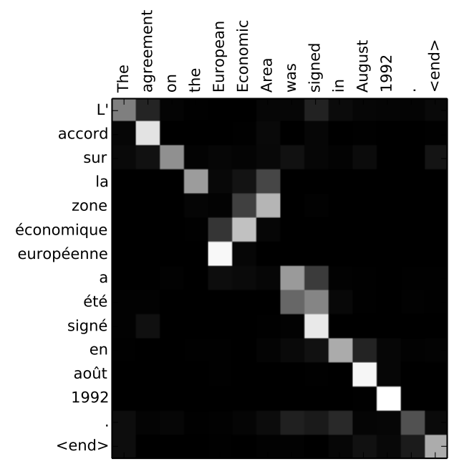
learning to pay attention
Machine Learning Methods for Biomedical Data (D012554)
Notes:
You can see how the model paid attention correctly when outputing "European Economic Area". In French, the order of these words is reversed ("européenne économique zone") as compared to English. Every other word in the sentence is in similar order.

Slide 22

attention is all you need
The transformer architecture is the current state of the art (I think…).
Ashish Vaswani et al., Attention is all you need. (NIPS'17)
Machine Learning Methods for Biomedical Data (D012554)

